Slide 1
Computer Networks
Data Link Layer
Adrian Sergiu DARABANT
Lecture 5

Slide 2

The Data Link Layer
All People Seem To Need Data Processing

Slide 3
Data Link Layer Services
Framing and link access
Reliable delivery
Flow Control
Error Detection
Error Correction
Half-Duplex, Full-Duplex

Slide 4
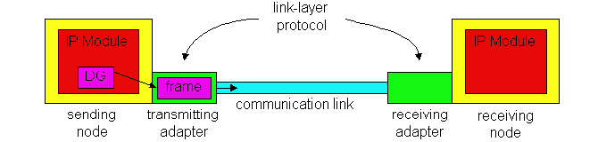
Adapters implementing the Link layer protocol

Slide 5
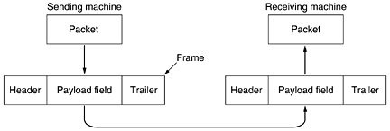
Packets-Frames Relationship

Slide 6
Services provided for the Network Layer
Unacknowledged connectionless
Acknowledged connectionless
Acknowledged connection-oriented

Slide 7
Framing
Character Count
Flag byte with stuffing
Starting and ending flags with bit stuffing;
Physical Layer coding violations

Slide 8
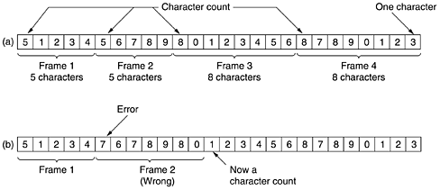
Character Count

Slide 9
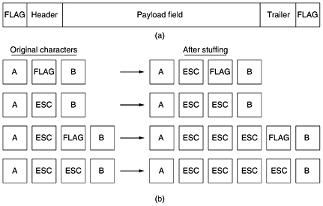
Flag byte + Byte Stuffing

Slide 10
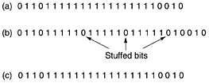
Unicode (multiple bytes characters) Bit Stuffing
Flag - 01111110
“In data sequence” 01111110 transmitted as 011111010

Slide 11
Flow Control
Feedback based
  Receiver sends information back to the sender allowing it to send more data
Rate-based
  No feedback

Slide 12
Data Link Protocols
HDLC- High Level Data Link Protocol
PPP – Point to Point Protocol
Ethernet 802.3 and Wireless 802.11
All are bit oriented protocols
All differ only on minor yet irritating aspects

Slide 13

Bit oriented protocols – Frame structure
01111110 – flag – end start
Address – for identifying the terminal
Control – sequence numbers, ack, etc
Data – any information
Checksum – cyclic redundancy code
On idle lines – flag seq sent continuously

Slide 14
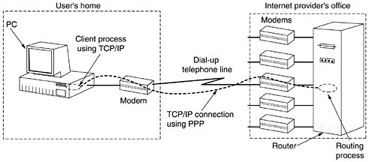
The Internet Data Link Layer

Slide 15
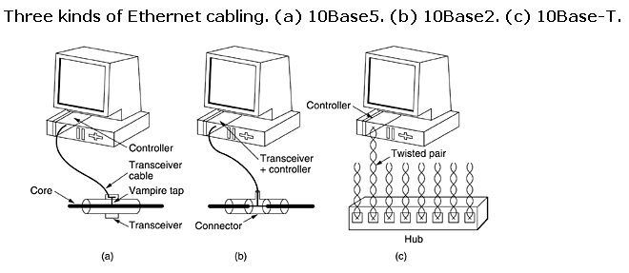
Ethernet

Slide 16

Ethernet 802.3
Preamble – 56 bit alternating 1 & 0s
SOF – Start of Frame Delimiter=10101011
Dest & Source – MAC addresses
Length – data length
If Lenght< 46 bytes ➔ pad
If Length>=1536 ➔ is a type=protocol

Slide 17
MAC Addresses
MAC address – 6 bytes –2⁴⁸ addresses
  281.474.976.710.656 distinct addresses
MAC addresses are burned into the network adapter’s ROM
Each Net. Adapt. Has a UNIQUE MAC
  Address space managed by IEEEE
  2²⁴ – company ID
  2²⁴ – adapter ID

Slide 18
MAC Addresses on a host
Linux – ifconfig eth0
  [root@dell ~]# ifconfig
  eth0 Link encap:Ethernet HWaddr 00:B0:D0:20:71:AA
  inet addr:172.30.106.3 Bcast:172.30.255.255 Mask:255.255.0.0
  UP BROADCAST RUNNING MULTICAST MTU:1500 Metric:1
  RX packets:952440 errors:0 dropped:0 overruns:0 frame:0
  TX packets:542834 errors:0 dropped:0 overruns:0 carrier:0
  collisions:0 txqueuelen:1000
  RX bytes:66501640 (63.4 MiB) TX bytes:781222697 (745.0 MiB)
Windows – ipconfig /all
Ethernet adapter Local Area Connection:
Connection-specific DNS Suffix . : lan
Description . . . . . . . . . . . : Broadcom NetXtreme 57xx Gigabit Controller
Physical Address. . . . . . . . . : 00-15-C5-0A-26-FE
Dhcp Enabled. . . . . . . . . . . : Yes
Autoconfiguration Enabled . . . . : Yes
IP Address. . . . . . . . . . . . : 192.168.0.13
Subnet Mask . . . . . . . . . . . : 255.255.255.0
Default Gateway . . . . . . . . . : 192.168.0.254
DHCP Server . . . . . . . . . . . : 192.168.0.254
Lease Obtained. . . . . . . . . . : 5 mai 2008 09:10:25
Lease Expires . . . . . . . . . . : 6 mai 2008 09:10:25

Slide 19
Why MAC addresses ?
To accommodate different protocols (not just IP)
Why not store IP addresses as MAC ?
  Need to rewrite the addresses whenever the computer moves
Broadcast media – why not pass every frame to the node ?
  To much processing….

Slide 20
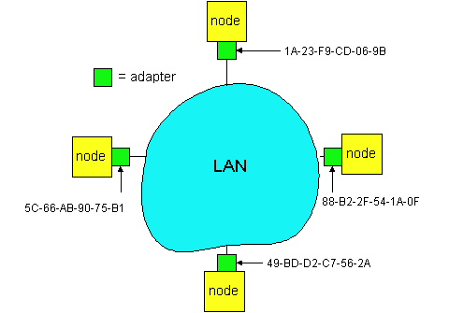
MAC Addresses and ARP

Slide 21
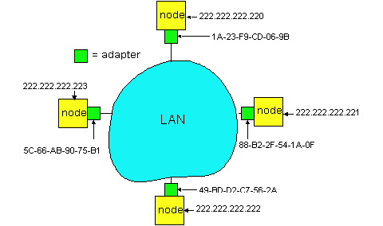
ARP- Address Resolution Protocol
FF-FF-FF-FF-FF-FF – broadcast address

Slide 22
ARP Tables
IP address
LAN address
TTL
222.222.222.221
88-B2-2F-54-1A-0F
13:45:00
222.222.222.223
5C-66-AB-90-75-B1
13:52:00
ARP – similar to DNS – just on local LANs
(/sbin/)arp –a (Windows + Linux)
l338_06.scs.ubbcluj.ro (172.30.38.6) at 00:50:70:D7:0E:7A [ether] on eth1
win.scs.ubbcluj.ro (172.30.0.14) at 00:30:05:C2:36:C8 [ether] on eth1
l336_09.scs.ubbcluj.ro (172.30.36.9) at 00:1D:60:9F:16:9D [ether] on eth1
l308_04.scs.ubbcluj.ro (172.30.8.4) at 00:50:70:D7:14:72 [ether] on eth1
rares_sun (193.226.40.145) at 00:19:21:30:4C:3C [ether] on eth1
? (172.30.111.6) at 00:13:02:D3:DC:B4 [ether] on eth1
dan (193.226.40.147) at <incomplete> on eth1

Slide 23
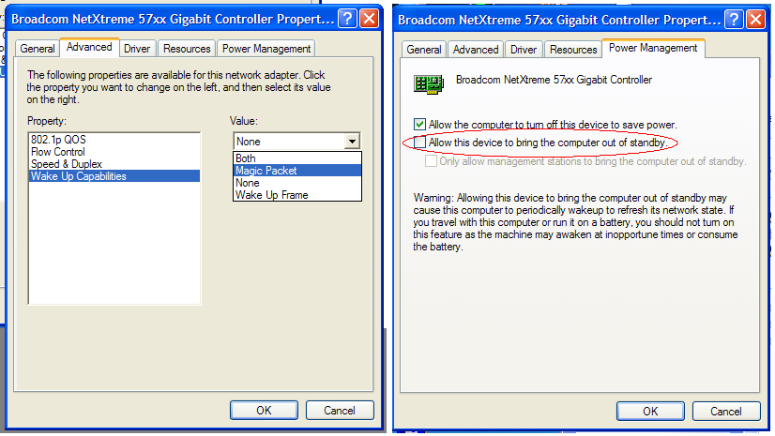
Wake on Lan (ethernet only)
Linux – ethtool –s wol g eth0
p| u | g |b | a| s |d= Phys activity|unicast|broadcast|ARP|
|SecureOnPassw|disable

Slide 24
PPP – Point to Point Protocol
Provides
  Framing + error detection
  Link Control Protocol – brings lines up, tears down, etc
  Network Control Protocol – negotiating network protocol

Slide 25

PPP packet structure
Protocol
bit 0=1 Negotiators: LCP, NCP
bit 0=0 network protocol – IP, IPX, etc

Slide 26
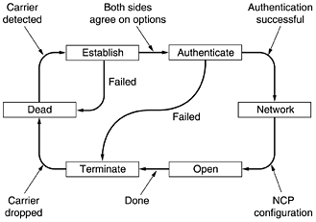
PPP

Slide 27
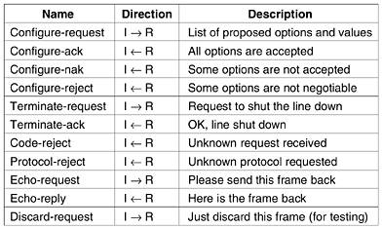
LCP Frame Types

Slide 28
Network Equipment
Network adapters
Hubs
Bridges
Switches

Slide 29
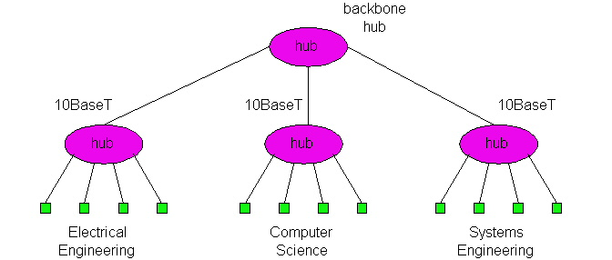
Hubs

Slide 30
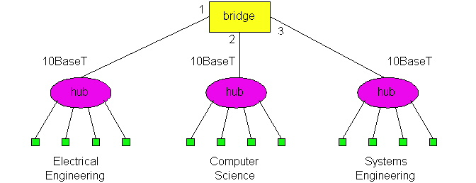
Bridges

Slide 31
Bridge Forwarding and Filtering
Address
Interface
Time
62-FE-F7-11-89-A3
1
9:32
7C-BA-B2-B4-91-10
3
9:36
...
...
...
Self learning components
Similar to NICs but no MAC Address

Slide 32
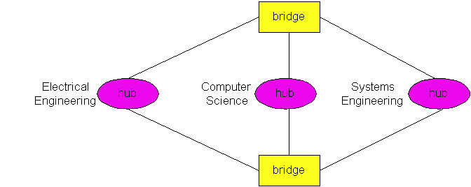
Spanning Tree

Slide 33

Bridges vs Routers

Slide 34
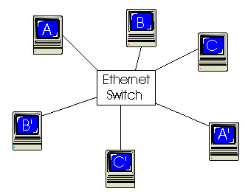
Switches
Switch = Bridge with many interfaces (> 4)
Full duplex mode
Dedicated Access – no collision

Slide 35
Features of interconnection devices
hubs
bridges
routers
Ethernet switches
traffic isolation
no
yes
yes
yes
plug and play
yes
yes
no
yes
optimal routing
no
no
yes
no
cut-through
yes
no
no
yes

